Slide 1
SS855 - Research Methodology in Applied Sciences Seminar on Overview of Methods in Statistics
Submitted to,
Dr Smitha Chandran S
Assistant Professor
Department of Chemistry
Submitted by,
M S Gayathri
(AM.PS.R4PHY24005)

Slide 2
Contents
Introduction to Statistics
Why is statistics important in research?
Methods in Statistics
References

Slide 3
Introduction to Statistics
Statistics is the study of the collection, organization, analysis, interpretation and presentation of data.
It is a mathematical discipline to collect and summarize data.

Slide 4
Why is statistics important in research?
It acts as a tool in designing research, analyzing its data and drawing conclusions therefrom.
Most research studies result in a large volume of raw data which must be suitably reduced so that the same can be read easily and can be used for further analysis.

Slide 5
Methods in Statistics
The large volume of numerical information gives rise to the need for systematic methods which can be used to organise, present, analyse and interpret the information effectively. Statistical methods were primarily developed to meet this need.
These methods help researchers and analysts make sense of data, draw conclusions and support decision-making.

Slide 6
The primary methods used in statistical research includes,
Descriptive Statistics
Inferential Statistics
Multivariate Analysis
Non-Parametric Methods
Time Series Analysis
Bayesian Statistics
Sampling Methods
Machine Learning Methods

Slide 7
Descriptive Statistics
It helps to present quantitative descriptions in a manageable form. Key components Include,
Descriptive Statistics
Measures of central tendency
Measures of Dispersion
Data visualization

Slide 8
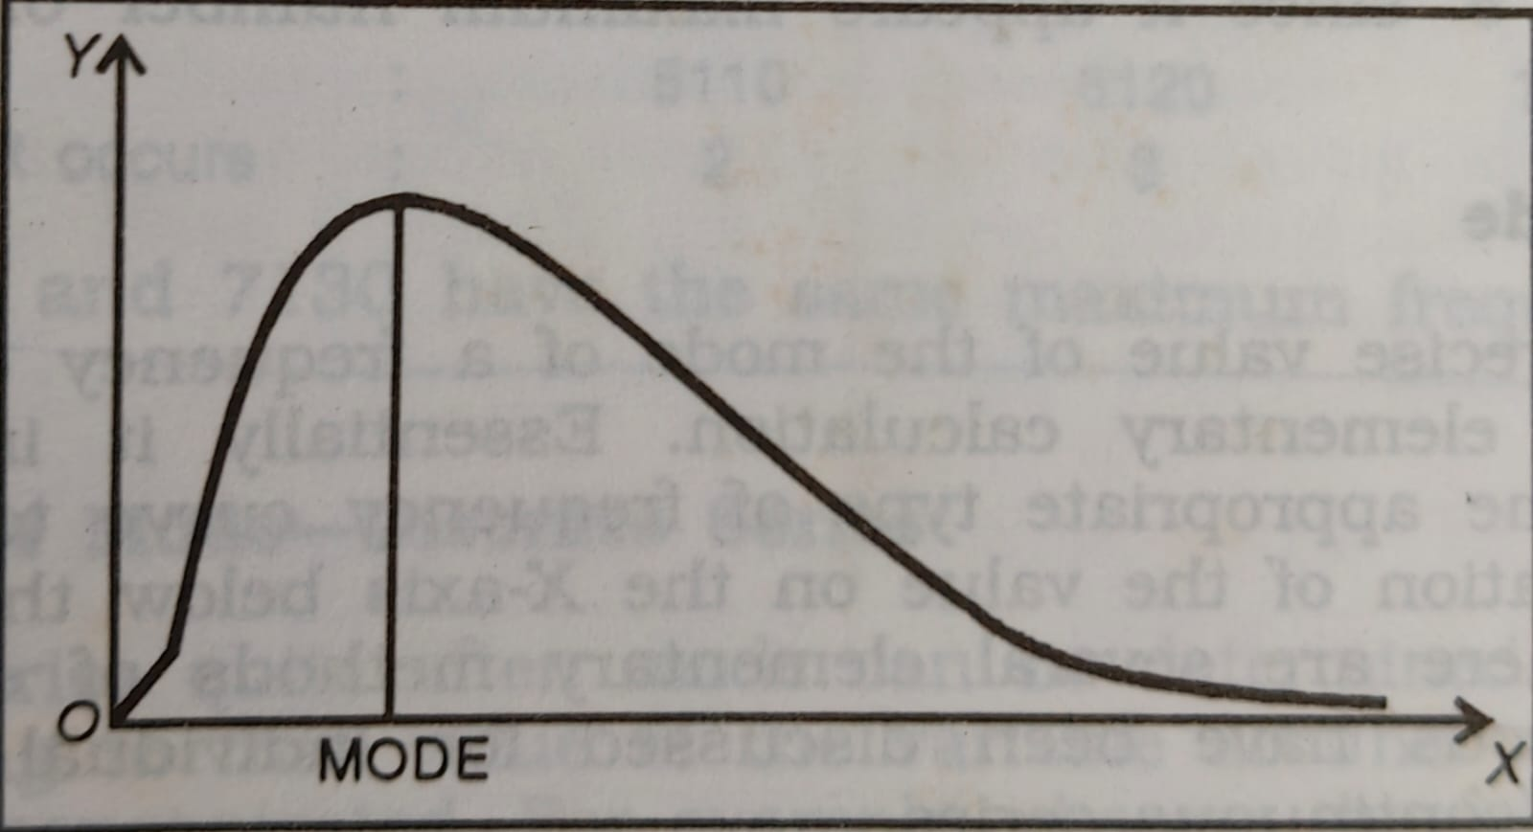
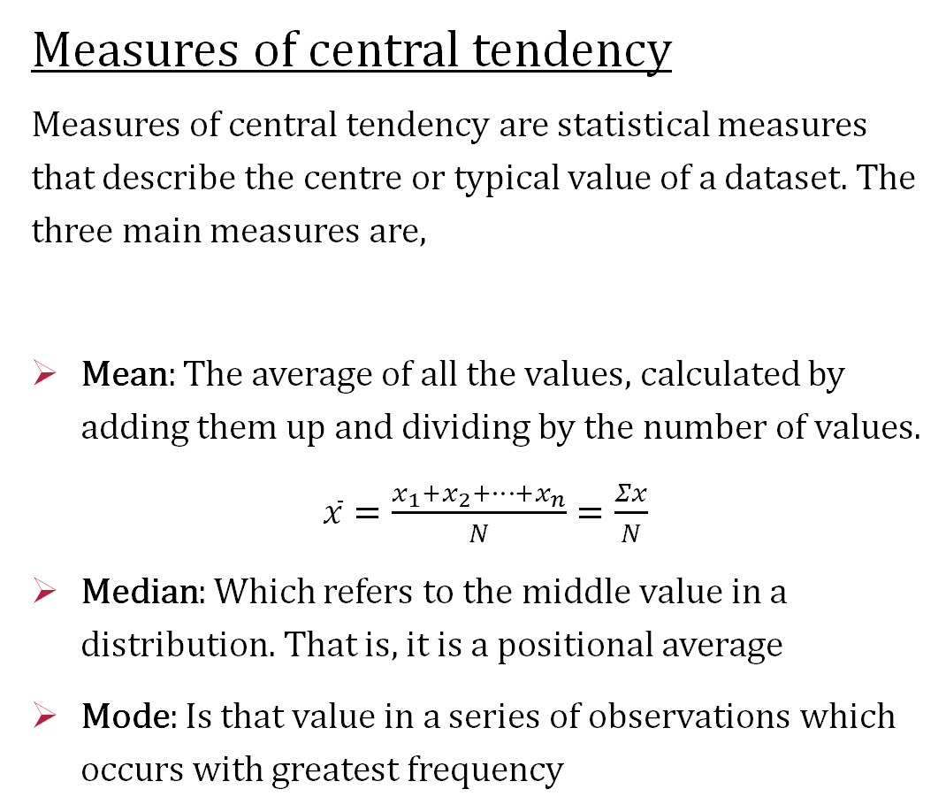
Measures of central tendency
Measures of central tendency are statistical measures that describe the centre or typical value of a dataset. The three main measures are,
Mean: The average of all the values, calculated by adding them up and dividing by the number of values.
$\overline{x}=\frac{x_{1}+x_{2}+…+x_{n}}{N}=\frac{Σx}{N}$
Median: Which refers to the middle value in a distribution. That is, it is a positional average
Mode: Is that value in a series of observations which occurs with greatest frequency
The value of the variable at which the curve reaches a maximum is called the mode. It is the value around which the items tend to be most heavily concentrated.

Slide 9

Let’s consider a simple data set
3, 7, 7, 2, 5
Mean = $\frac{3+7+7+2+5}{5}=4.8$
Median
To find the median, first, arrange the numbers in ascending order:
Ordered Data Set: 2, 3, 5, 7, 7
Median = 5
Mode
In our data set, the number 7 appears twice
Mode = 7

Slide 10
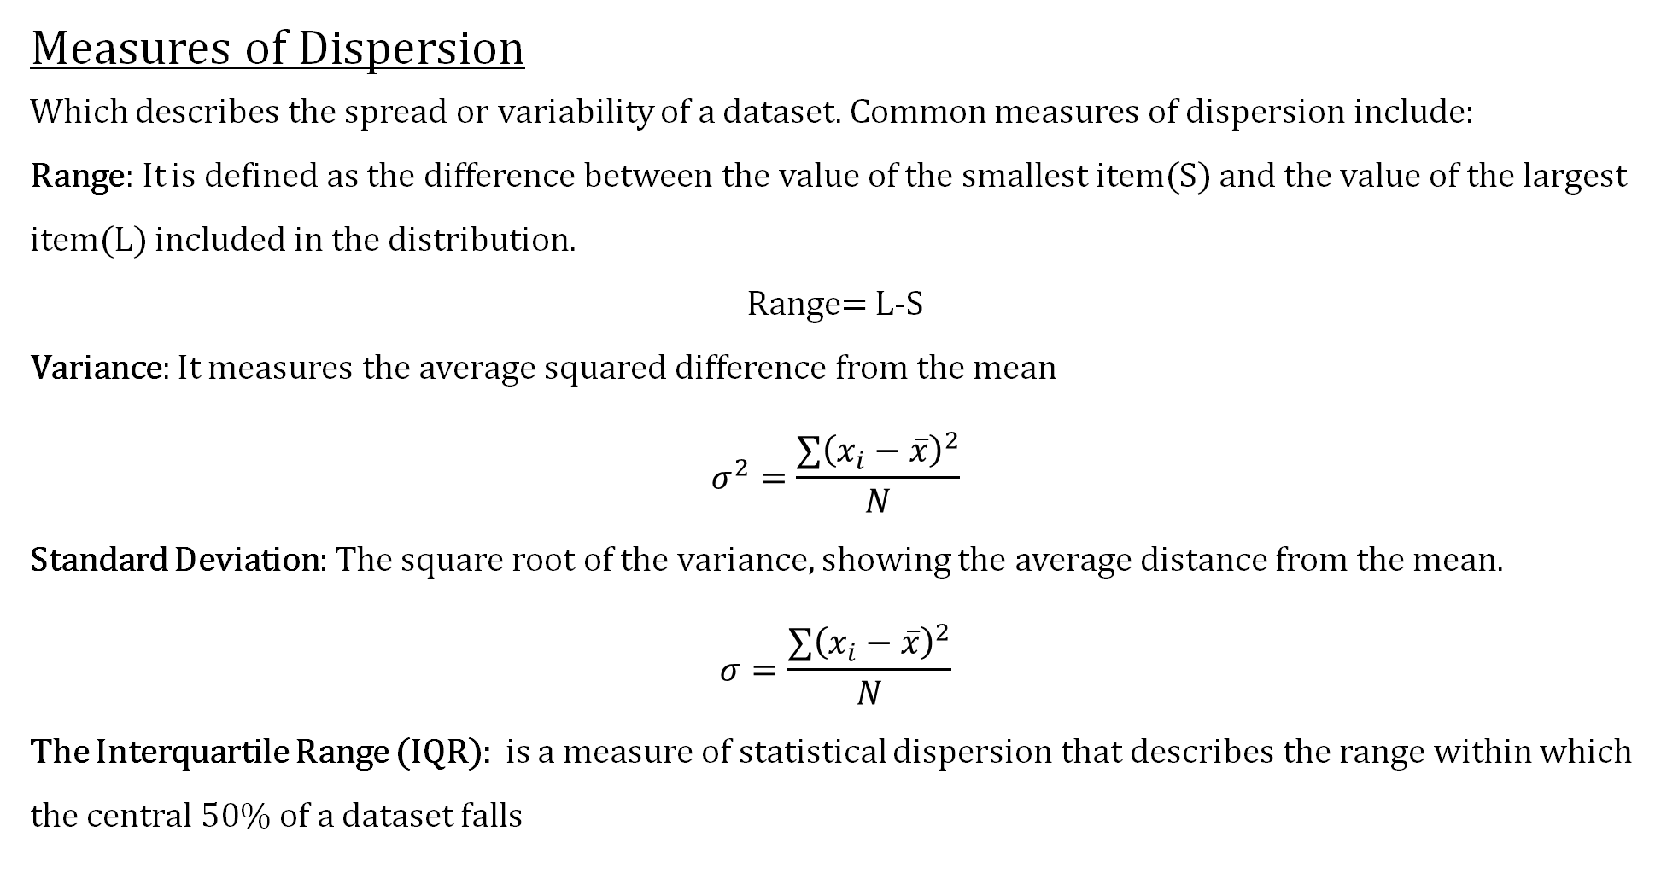
Measures of Dispersion
Which describes the spread or variability of a dataset. Common measures of dispersion include:
Range: It is defined as the difference between the value of the smallest item(S) and the value of the largest item(L) included in the distribution.
Range= L-S
Variance: It measures the average squared difference from the mean
$$σ^{2}=\frac{∑{\left(x_{i}−\overline{x}\right)}^{2}}{N}$$
Standard Deviation: The square root of the variance, showing the average distance from the mean.
$$σ=\frac{∑{\left(x_{i}−\overline{x}\right)}^{2}}{N}$$
The Interquartile Range (IQR): is a measure of statistical dispersion that describes the range within which the central 50% of a dataset falls

Slide 11
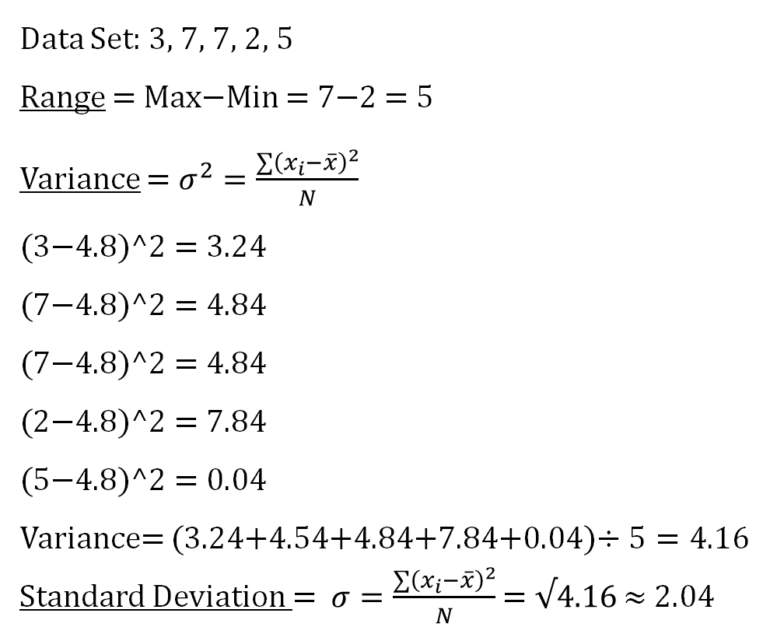
Data Set: 3, 7, 7, 2, 5
Range = Max−Min = 7−2 = 5
Variance = $σ^{2}=\frac{∑{\left(x_{i}−\overline{x}\right)}^{2}}{N}$
(3−4.8)^2 = 3.24
(7−4.8)^2 = 4.84
(7−4.8)^2 = 4.84
(2−4.8)^2 = 7.84
(5−4.8)^2 = 0.04
Variance= (3.24+4.54+4.84+7.84+0.04)$÷5=4.16$
Standard Deviation = $σ=\frac{∑{\left(x_{i}−\overline{x}\right)}^{2}}{N}$ = $√4.16$ ≈ 2.04
Interquartile Range (IQR),
arrange the data in ascending order
2, 3, 5, 7, 7
To find the quartiles:
Q1 (1st quartile) is the median of the first half (2, 3):
Q1=(2+3)/2=2.5
Q3 (3rd quartile) is the median of the second half (5, 7, 7):
Q3=7
IQR=Q3−Q1=7−2.5=4.5

Slide 12
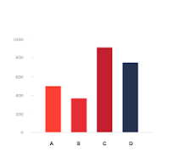
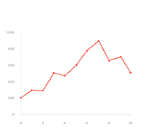
Data visualization
Data visualization is the graphical representation of data and information.
Bar Chart
Line Chart

Slide 13
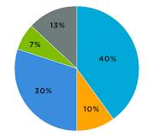
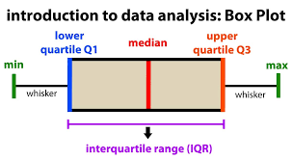
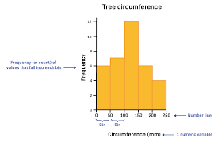
Pie Chart
Box plots
Histograms

Slide 14
Descriptive Statistics
Inferential Statistics
Multivariate Analysis
Non-Parametric Methods
Time Series Analysis
Bayesian Statistics
Sampling Methods
Machine Learning Methods

Slide 15
Inferential statistics
It is used by researchers to make inferences about a population based on data collected from a sample.
Inferential Statistics
Regression Analysis
Hypothesis Testing
Confidence Intervals

Slide 16
Regression Analysis
Regression is the measure of the average relationship between two or more variable in terms of the original units of the data.
Regression analysis is a statistical device with the help of which we are in a position to estimate the unknown values of one variable from the values of another variable.
The variable which is used to predict the variable of interest is known as the “independent variable” or “explanatory variable”, and the variable we are trying to predict is called the “dependent variable” or “explained variable”.

Slide 17
Hypothesis Testing
Null hypothesis and alternative hypothesis
Process of Hypothesis Testing
Formulate the Hypotheses
Choose a Significance Level
Collect Data
Calculate the Test Statistic
Determine the P-value
Make a Decision
Interpret the Results

Slide 18
Confidence Intervals
It provides a measure of uncertainty around a point estimate and indicates how much the estimate might vary due to sampling variability.
How to Calculate a Confidence Interval
Select a Point Estimate
Determine the Margin of Error (ME)
Calculate the Confidence Interval

Slide 19
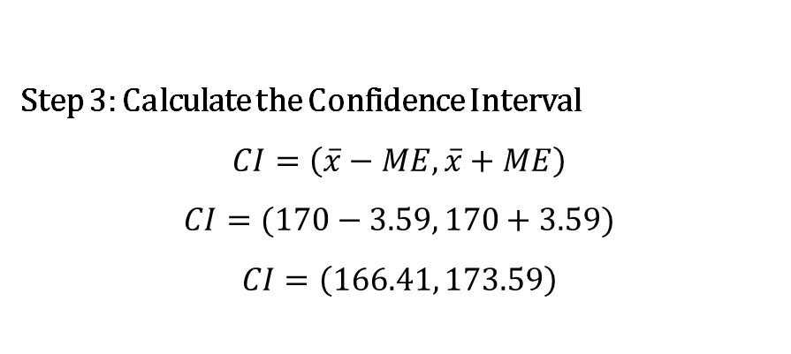
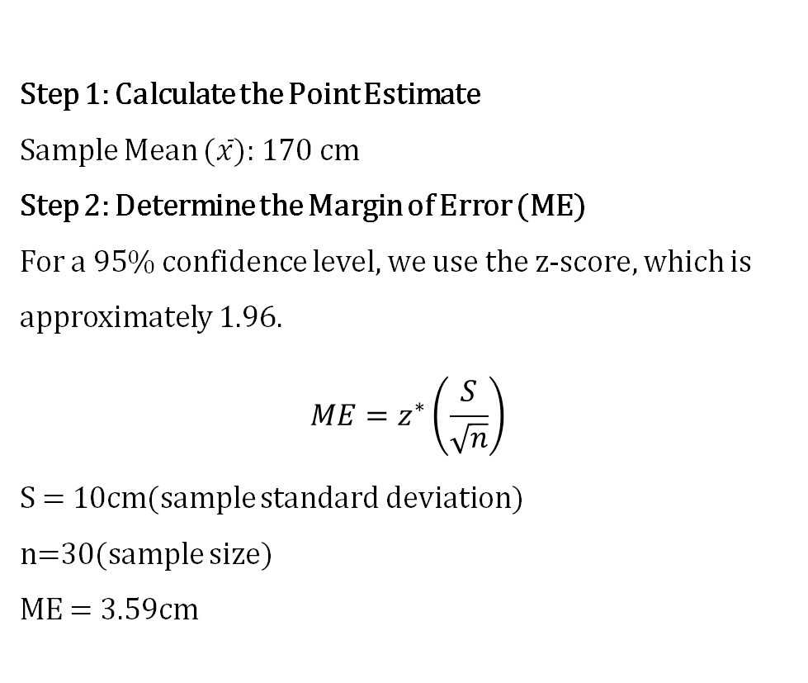
Scenario: Suppose a researcher wants to estimate the average height of students in a university. They randomly select a sample of 30 students and measure their heights. The sample mean height is 170 cm, and the sample standard deviation is 10 cm.
Step 1: Calculate the Point Estimate
Sample Mean ($\overline{x}$): 170 cm
Step 2: Determine the Margin of Error (ME)
For a 95% confidence level, we use the z-score, which is approximately 1.96.
$$ME=z^{∗}\left(\frac{S}{\sqrt{n}}\right)$$
S = 10cm(sample standard deviation)
n=30(sample size)
ME = 3.59cm
Step 3: Calculate the Confidence Interval
$$CI=\left(\overline{x}−ME,\overline{x}+ME\right)$$
$$CI=(170−3.59, 170+3.59)$$
$$CI=\left(166.41, 173.59\right)$$

Slide 20
Descriptive Statistics
Inferential Statistics
Multivariate Analysis
Non-Parametric Methods
Time Series Analysis
Bayesian Statistics
Sampling Methods
Machine Learning Methods

Slide 21
Multivariate Analysis
Mostly statistical techniques focus on just one or two variables.
Multivariate analysis (MVA) techniques allow more than two variables to be analysed at once
Dependence techniques are appropriate when one or more variables can be identified as dependent variables and the remaining as independent variables.
In interdependence techniques, the variables are not classified as dependent or independent; rather, the whole set of interdependent relationships is examined.

Slide 22
Multivariate Analysis
Dependence Variable
Independence Variable
One dependent variable
More than One dependent variable
Variable interdependence
Inter object similarity
Cross tabulation, Analysis of variance and covariance, Multiple regression, Conjoint analysis
Multivariate Analysis of variance and covariance, Canonical correlation, Multiple discriminant analysis
Factor Analysis
Cluster analysis, Multidimensional scaling

Slide 23
Descriptive Statistics
Inferential Statistics
Multivariate Analysis
Non-Parametric Methods
Time Series Analysis
Bayesian Statistics
Sampling Methods
Machine Learning Methods

Slide 24
Non-parametric methods
This technique do not assume a specific distribution for the data.
They are particularly useful when the underlying distribution is unknown or when the data do not meet the assumptions of parametric tests.
Non parametric methods
Sign test
Wilcoxon signed rank test
Mann whitney Wilcoxon test
Kruskal wallis test

Slide 25
Sign Test: This test is used to evaluate the median of a population when the data do not necessarily follow a normal distribution.
Wilcoxon signed rank test: The Wilcoxon Signed-Rank Test is a non-parametric statistical test used to compare two related samples or matched observations
Mann whitney Wilcoxon test : The Mann-Whitney U Test, also known as the Mann-Whitney Wilcoxon Test, is a non-parametric statistical test used to compare two independent groups to determine whether their population distributions differ.
Kruskal Wallis test : used to compare three or more independent groups to determine if there are statistically significant differences in their distributions.

Slide 26
Descriptive Statistics
Inferential Statistics
Multivariate Analysis
Non-Parametric Methods
Time Series Analysis
Bayesian Statistics
Sampling Methods
Machine Learning Methods

Slide 27
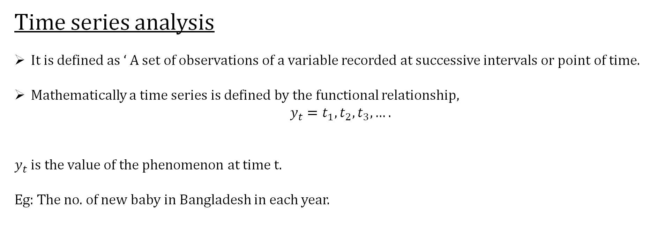
Time series analysis
It is defined as ‘ A set of observations of a variable recorded at successive intervals or point of time.
Mathematically a time series is defined by the functional relationship,
$$y_{t}=t_{1},t_{2},t_{3},….$$
$y_{t}$ is the value of the phenomenon at time t.
Eg: The no. of new baby in Bangladesh in each year.

Slide 28
Time series components
Trend component
Seasonal component
Cyclical component
Random component
Long term, underlying direction or pattern in data over a period of time.
Eg: Population growth.
Repeating pattern usually within 12 month period.
Eg: Electricity demand.
Repeating swings more than one year.
Eg: Stock market.
Unpredictable or irregular fluctuations in data.
Eg: Measurement of errors.

Slide 29
Descriptive Statistics
Inferential Statistics
Multivariate Analysis
Non-Parametric Methods
Time Series Analysis
Bayesian Statistics
Sampling Methods
Machine Learning Methods

Slide 30
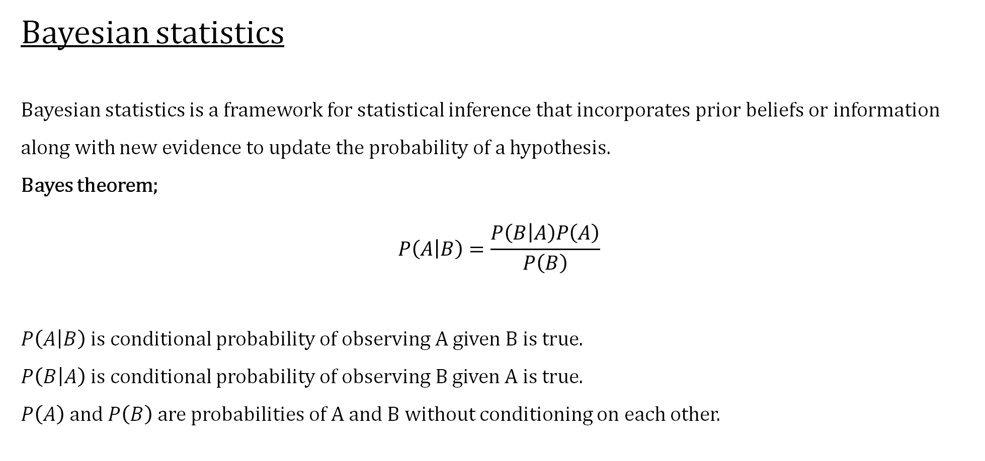
Bayesian statistics
Bayesian statistics is a framework for statistical inference that incorporates prior beliefs or information along with new evidence to update the probability of a hypothesis.
Bayes theorem;
$$P\left(\left.A\right|B\right)=\frac{P\left(\left.B\right|A\right)P\left(A\right)}{P\left(B\right)}$$
$P\left(\left.A\right|B\right)$ is conditional probability of observing A given B is true.
$P\left(\left.B\right|A\right)$ is conditional probability of observing B given A is true.
$P\left(A\right)$ and $P\left(B\right)$ are probabilities of A and B without conditioning on each other.

Slide 31
Imagine there's a disease that affects 1% of a population. A test for the disease is available, which correctly identifies a sick person 90% of the time (true positive rate) and correctly identifies a healthy person 95% of the time (true negative rate).
P(Disease)=0.01
P(No Disease)=1−P(Disease)=0.99
P(Positive Test∣Disease)=0.9
P(Positive Test∣No Disease)=0.05
P(Disease∣Positive Test)= P(Positive Test∣Disease)⋅P(Disease) ≈ 0.154
P(Positive Test)
So, even with a positive test result, the probability that a person actually has the disease is about 15.4%.

Slide 32
Descriptive Statistics
Inferential Statistics
Multivariate Analysis
Non-Parametric Methods
Time Series Analysis
Bayesian Statistics
Sampling Methods
Machine Learning Methods

Slide 33
Sampling Methods
This method is used to select a subset of individuals or observations from a larger population to gather data and make inferences about that population. It includes,
Simple Random Sampling: Each member of the population has an equal chance of being selected.
Systematic Sampling: Members of the population are selected at regular intervals. For example, you might choose every 10th person from a list.
Stratified Sampling: The population is divided into subgroups (strata) and samples are drawn from each stratum.
Cluster Sampling: The population is divided into clusters and entire clusters are randomly selected.
Convenience Sampling: Samples are taken from a group that is easily accessible
Judgmental or Purposive Sampling: Researchers use their judgment to select individuals who are believed to be representative of the population.

Slide 35
Descriptive Statistics
Inferential Statistics
Multivariate Analysis
Non-Parametric Methods
Time Series Analysis
Bayesian Statistics
Sampling Methods
Machine Learning Methods

Slide 36
Machine learning methods
They combine statistical principles with algorithms to identify patterns, classify data, and make predictions without being explicitly programmed for each task.
Machine learning methods
Supervised Learning
Unsupervised Learning
Semi-Supervised Learning
Linear and Logistic Regression, Decision Trees, Support Vector Machines
Clustering, Dimensionality Reduction

Slide 37
Supervised Learning: This model is trained on a labelled dataset, where the outcome is known. The goal is to learn a mapping from inputs to outputs.
Unsupervised Learning: Unsupervised learning deals with unlabelled data, aiming to identify patterns or groupings without predefined outcomes.
Semi-Supervised Learning: This method combines a small amount of labelled data with a large amount of unlabelled data, improving learning accuracy. It’s particularly useful when labelling data is expensive or time-consuming.

Slide 38
Descriptive Statistics
Inferential Statistics
Multivariate Analysis
Non-Parametric Methods
Time Series Analysis
Bayesian Statistics
Sampling Methods
Machine Learning Methods

Slide 39
References
“Research Methodology, Methods and Techniques” C R Kothari, Gaurav Gang
“Statistical Methods” S P Gupta
Various Online Platforms.

Slide 40
Thank You

